Slide 1
Leveraging Crowdsourced Data for Traffic Congestion Prediction and Management
WQD7025
Data Science Research Project (P2)
Tan Jian Lin
17207012
Supervisor : Assoc. Prof. Dr. Ang Tan Fong

Slide 2
Contents
Introduction
Problem Statements
Research Question
Objectives
Literature Reviews
Research Methodology
System Design
Result Analysis
Deployment
Conclusion

Slide 3
Introduction
Crowdsourced data refers to information that is collected and shared by many individuals through digital platforms, mobile applications, or online communities.
In traffic management, navigation applications like Waze and Google Maps generate vast amounts of data, including congestion levels, road incidents, and travel speeds.
To make use of this rich data source, machine learning approaches have emerged as powerful tools for traffic congestion prediction.
This study aims to explore how crowdsourced data can be effectively integrated into machine learning models to enhance traffic congestion prediction and management.

Slide 4

Introduction
SDG 11 – Sustainable Cities and Communities
Efficient traffic congestion prediction contributes to more sustainable and resilient cities by reducing travel delays.
By integrating data from navigation apps, this study supports better decision-making for urban traffic management, leading to reduced environmental impact and improved life quality.

Slide 5
Problem Statements
Traffic congestion in major urban areas has become a significant challenge, impacting daily commutes, economic productivity, and environmental sustainability (Huang & Loo, 2022).
Traditional traffic management systems often rely on static data sources, which may fail to reflect the real situations in traffic flow.
The navigation applications generate vast amounts of crowdsourced data which are not fully utilized in traffic prediction system.
The potential for effectively integrating the crowdsourced data into existing traffic prediction and management systems remains largely unexplored (Niu & Silva, 2020).

Slide 6
Research Questions
How can crowdsourced data be integrated into traffic prediction systems?
Which machine learning models can be used to predict traffic congestion using crowdsourced data?
How do different machine learning models perform in predicting traffic congestion based on various evaluation metrics?

Slide 7
Objectives
To explore the crowdsourced data integration methods with traffic prediction system.
To predict traffic congestion based on data from crowdsourced platforms using machine learning models.
To evaluate the performance of various models in terms of MAE, RMSE, R² and MAPE.

Slide 8
Literature Reviews
Recently researchers have applied various machine learning models using different types of data sources.
No. | Author & Year | Title | Objectives | Dataset | (Techniques | Results | Limitations
1. | Aljuaydi, F., Wiwatanapataphee, B., & Wu, Y. H. (2023) | Multivariate machine learning-based prediction models of freeway traffic flow under non-recurrent events. | To develop machine learning models for predicting freeway traffic flow during non-recurrent events like accidents and rainfall. | Traffic data is collected from Main Road Western Australia (WRWA) (429,120 observations) | MLP, CNN, LSTM, 1D CNN-LSTM, Autoencoder LSTM | 1D CNN-LSTM model was found to outperform the others in predicting traffic flow parameters | Complexity due to the hybrid nature of the model.
2. | Bai, M., Lin, Y., Ma, M., Wang, P., & Duan, L. (2021) | PrePCT: Traffic congestion prediction in smart cities with relative position congestion tensor. | To predict road network congestion using a novel Relative Position Congestion Tensor (RPCT) and a lightweight ConvLSTM-based neural network. | Speed data from Caltrans Performance Measurement System (PeMS) (2,853,552 records) | PrePCT model (based on ConvLSTM), ARIMA, SVR, RF, GBR, LSTM, and PCNN | PrePCT achieved the best performance across all benchmarks, especially in high-congestion zones, using RMSE and MAE as metrics. | Does not account for external factors like weather, accidents, or road closures.

Slide 9
Literature Reviews (Cont’d)
No. | Author & Year | Title | Objectives | Dataset | Techniques | Results | Limitations
3. | Bilotta, S., Collini, E., Nesi, P., & Pantaleo, G. (2022) | Short-term prediction of city traffic flow via convolutional deep learning. | Develop a deep learning model for short-term traffic flow prediction in urban areas. | Traffic flow data from 135 sensors in Florence, Italy, from September 2019 to February 2020. (appx millions rows) | CONV-BI-LSTM, LSTM, BI-LSTM, Autoencoder BI-LSTM, attention-based CONV-LSTM, RF, XGBOOST, DNN. | CONV-BI-LSTM outperformed other models with a MAPE of 15.35% | High computational demands; training time could be prohibitive for large-scale deployments.
4. | Duan, J. H., Li, W., Zhang, X., & Lu, S. (2022) | Forecasting fine-grained city-scale cellular traffic with sparse crowdsourced measurements. | To predict city-wide fine-grained cellular traffic patterns from sparse crowdsourced data using deep generative modeling. | Two real-world cellular traffic datasets released by Telecom Italia. (appx millions rows) | ARIMA, LSTM+SAE, ConvLSTM, ZipNet-GAN, CrowdGAN | CrowdGAN reduced RMSE by up to 47% compared to baseline models. | CrowdGAN still requires a large amount of traffic data for model training.

Slide 10
Literature Reviews (Cont’d)
No. | Author & Year | Title | Objectives | Dataset | Techniques | Results | Limitations
5. | Hu, S., Wang, K., Li, L., Zhao, Y., He, Z., & Zhang, Y. (2024) | Multi-crowdsourced data fusion for modeling link-level traffic resilience to adverse weather events. | To assess the accuracy and resilience of traffic flow estimates from Waze's user-reported and passive data (PCLD and ACUR), especially during extreme weather events. | INRIX PCLD, Waze ACUR, POI visit data from SafeGraph (for travel demand) (Size not specified) | Generalized Additive Models (GAM) | GAM achieves MAPE ranging from 20.89 % to 29.62 % under difference scenario. | The study only identifies correlations, it does not prove that weather events directly cause traffic changes.
6. | Tay, L., Lim, J. M. Y., Liang, S. N., Keong, C. K., & Tay, Y. H. (2023) | Urban traffic volume estimation using intelligent transportation system crowdsourced data. | To estimate urban traffic volume across an entire traffic network (Kuala Lumpur) using only partial sensor data (~10%) combined with crowdsourced traffic flow data, with minimal cost and high accuracy. | Sensor data from DBKL, Crowdsourced data from HERE Technologies, Map data from OpenStreetMap (50,000 rows) | Decision Tree, Proposed Spatial Random Forest (PSRF), RF with XGBoost, Neural Network and K-nearest Neighbour | PSRF achieved R² of 0.990, MAPE of 1.73% after fine tuned | Relies on HERE API, which may limit replicability in other regions

Slide 11
Literature Reviews (Cont’d)
No. | Author & Year | Title | Objectives | Dataset | Techniques | Results | Limitations
7. | Osei, K. K., Adams, C. A., Sivanandan, R., & Ackaah, W. (2022) | Modelling of segment level travel time on urban roadway arterials using floating vehicle and GPS probe data | To model travel times on urban roads using floating vehicle and GPS data. | Collected from vehicles equipped with GPS devices and the "My Tracks" Android application. (appx thousands rows) | Multiple Linear Regression with stepwise backward selection based on Akaike Information Criterion (AIC).: Model 1 (5 variables) Model 2 (2 variables | Model 2 has better performance with RMSE: 0.47 seconds, MAE: 0.37 seconds, and MAPE: 7.2% | Relies on manual data collection (moving observer method), limiting scalability.
8. | Qaddoura, R., Younes, M. B., & Boukerche, A. (2024). | Towards optimal tuned machine learning techniques based vehicular traffic prediction for real roads scenarios. | Improve traffic prediction using optimized machine learning models across different global road scenarios. | Traffic data simulated using SUMO (Simulation of Urban MObility) for real road scenarios in four countries (appx thousands rows) | Linear Regression, Decision Tree, KNN | KNN achieved a 33% improvement in R² and 35% reduction in RMSE for 1-minute speed prediction. | Data is simulated, not collected from real sensors or navigation apps

Slide 12
Literature Reviews (Cont’d)
No. | Author & Year | Title | Objectives | Dataset | Techniques | Results | Limitations
9. | Ramchandra, N. R., & Rajabhushanam, C. (2022) | Machine learning algorithms performance evaluation in traffic flow prediction. | Demonstrates the significance of using advanced ML techniques for dynamic traffic flow forecasting. | Traffic flow data from an online dataset, source and size not specified | DAN, DBN, Random Forest, LSTM | LSTM outperformed the other models, showing superior accuracy (95.2%) | Advanced models like LSTM require significant computational resources for training.
10. | Yi, Z., Liu, X. C., Markovic, N., & Phillips, J. (2021) | Inferencing hourly traffic volume using data-driven machine learning and graph theory | Predict hourly traffic volume using machine learning while accounting for spatial dependencies across road networks | Probe vehicle data is provided by INRIX. (384,879 rows) | - XGBoost, XGBoost with BFS Algorithm, XGBoost with a spatial dependency feature | XGBoost with BFS Algorithm outperformed other models with R² (0.90), MAE (503 veh/h) & MAPE (0.79%) | The BFS approach relies on the quality of trajectory data, which may be sparse or unevenly distributed.

Slide 13
Literature Reviews Summary
Most studies rely on traditional data source which require expensive infrastructure (e.g., GPS, sensors, probe vehicle).
Some works use crowdsourced data, but focus mainly on traffic volume, not on predicting delay times.
Many advanced deep learning models are used but they often required large-scale datasets (>1M samples) and GPU resources to achieve optimal performance. Simpler models like KNN demonstrate comparable accuracy with significantly smaller datasets.
MAE and RMSE are the evaluation metrics which are used in the 10 papers. MAPE is used in most of the papers and R² is only used in few papers.

Slide 14
Research Methodology
Literature review
Data Collection
Data Preprocessing
Results Reporting
Model Training
Model Evaluation
Feature Engineering
EDA
Achieving RO1
Achieving RO2
Achieving RO3
Web of Science
Scopus
Dataset from Waze for cities program in Brno, Czech
Handle missing values
Handle Outliers
Decoding
Histogram
Boxplot
Correlation matrix
Statistical test
Encoding
Extract features
RF
KNN
LR
XGB
RFECV
Tuning
RMSE
MAE
R²
MAPE
Best model
Feature importance
SHAP

Slide 15
Dataset
Column | Description
country | Country code
level | Congestion level
city | City name
speedKMH | Speed in kilometers per hour
length | Road segment length (in meters)
turnType | Type of turn
globalid | Unique global ID for the road segment
type | Empty column
uuid | Unique identifier
endNode | Name of the end node or direction
speed | Alternate speed measure in m/s
blockingAlertUuid | ID of alert if blocking occurred
roadType | Road type as numeric code
delay | Traffic delay (in seconds)
street | Street name
objectid | Internal object ID
pubMillis | Timestamp of the data (in UTC)
Program: Waze for Cities – Brno City
Source: European Open Data Portal
Date Range: March 6, 2024 – March 7, 2025
Size: 10,000 rows × 17 columns
Notes:
https://data.europa.eu/data/datasets/https-kod-brno-cz-nkod-dataset-a20869c60f024dbbadf82a581617e898_0-ttl?locale=en

Slide 16
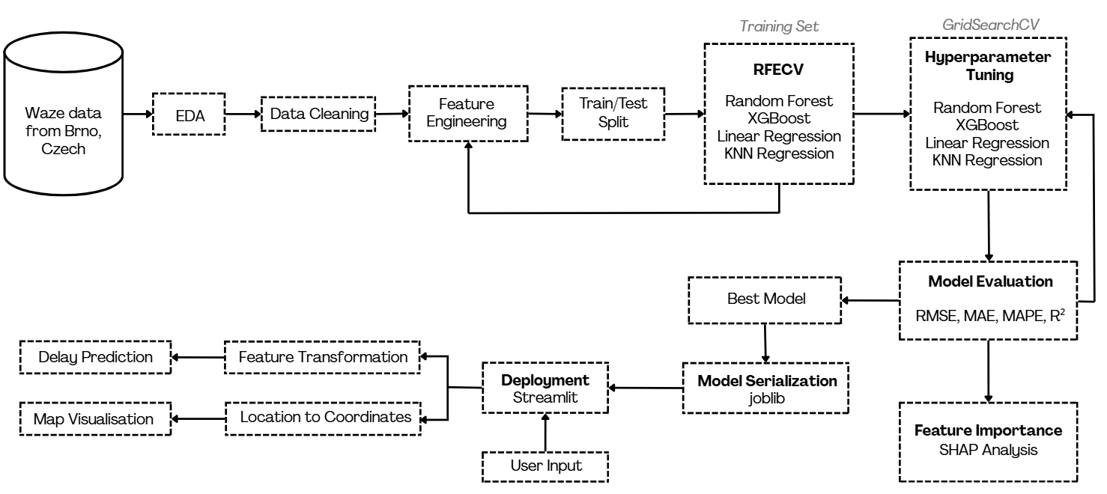
System Design

Slide 17
EDA
Attribute | Type | Count | Missing | Minimum | Maximum | Mean | Std. Dev.
level | Int64 | 10,000 | 0 | 1 | 5 | 3.05 | 0.85
city | Object | 9,999 | 1 | - | - | - | -
speedKMH | Int64 | 10,000 | 0 | 0 | 83 | 10.89 | 9.2
length | Int64 | 10,000 | 0 | 8 | 10,198 | 522.72 | 710.94
type | Float64 | 0 | 10,000 | - | - | - | -
endNode | Object | 7,161 | 2,839 | - | - | - | -
speed | Int64 | 10,000 | 0 | 0 | 23 | 3.01 | 2.58
blockingAlertUuid | Object | 307 | 9,693 | - | - | - | -
roadType | Int64 | 10,000 | 0 | 1 | 20 | 2.52 | 2.14
delay | Int64 | 10,000 | 0 | -1 | 2,084 | 117.14 | 111.86
street | object | 9,611 | 389 | - | - | - | -
pubMillis | object | 10,000 | 0 | - | - | - | -
city: 1 missing value to be imputed.
street: 389 missing (3.89%) to be imputed
endNode: ~28% missing to be dropped.
blockingAlertUuid: to be dropped.
type: 100% missing to be dropped.
Delays are highly skewed up to 2,084 seconds.
Speed and length also have wide ranges to be winsorized for modeling.

Slide 18
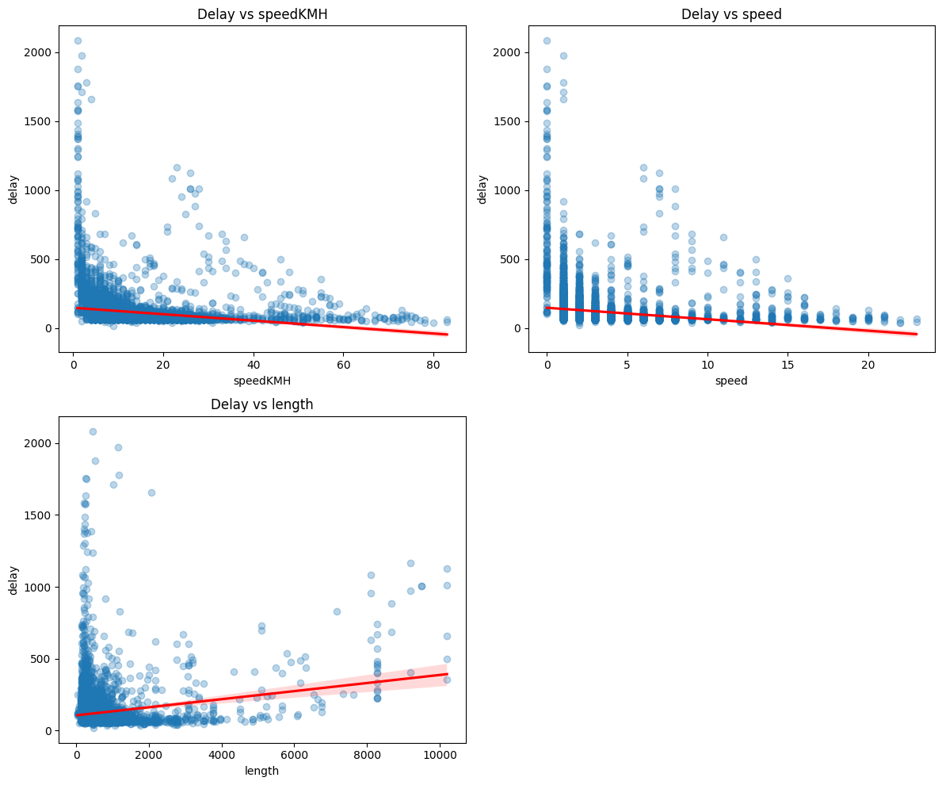
EDA
Negative relationship
Higher average speeds correspond to lower delays.
Negative relationship
Higher average speeds correspond to lower delays.
Positive relationship
Longer trip length is associated with slightly higher delays.

Slide 19
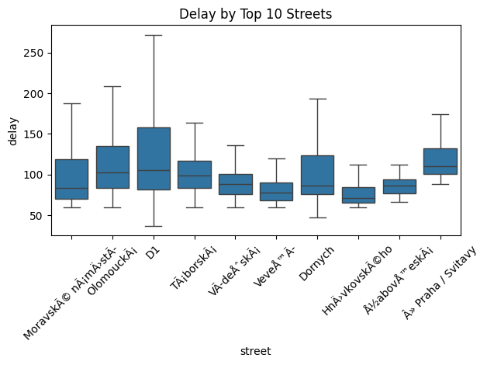
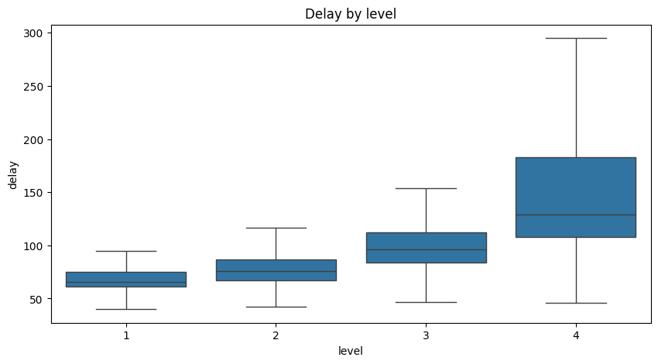
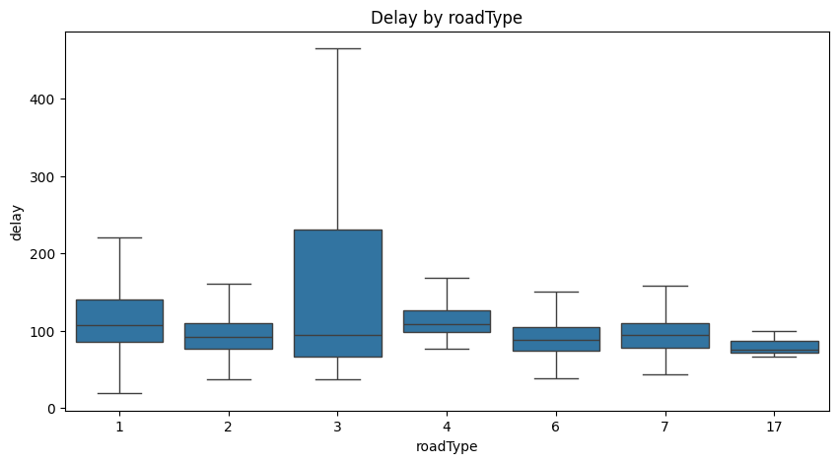
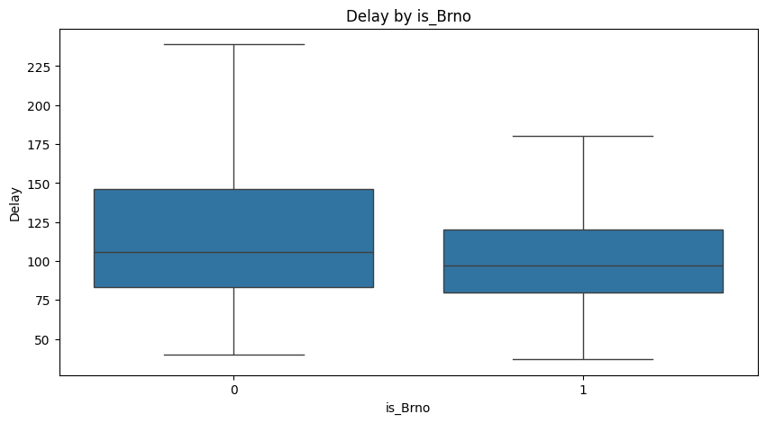
EDA
As the level increases from 1 to 4, the delay also increases.
Streets like D1 shows higher median and variability in delay.
Road Type 3 shows the widest spread and the highest maximum delay
Most of the cities are in Brno, the delays are slightly higher outside Brno

Slide 20
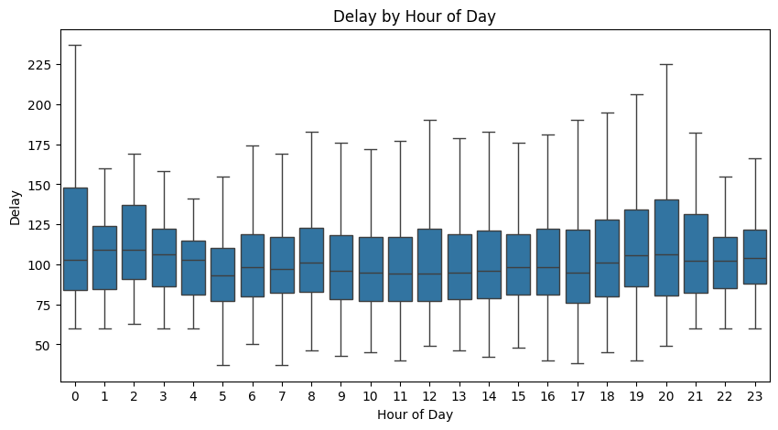
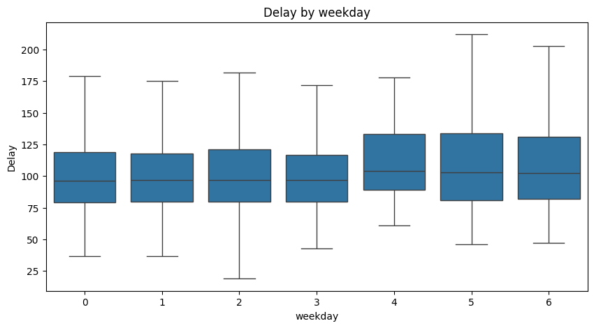
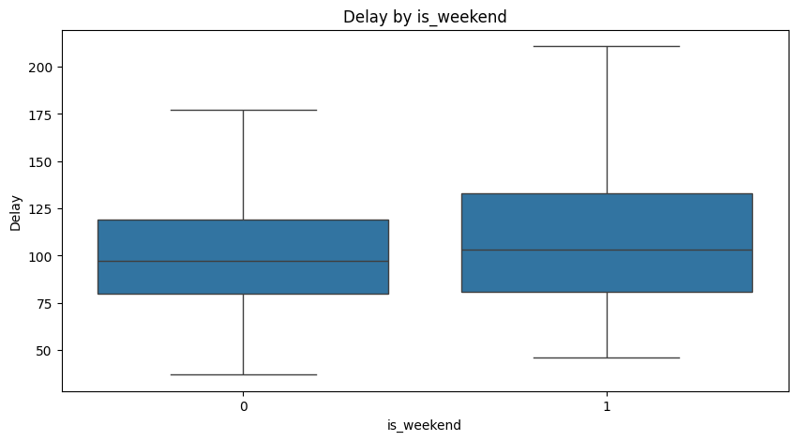
EDA - Timestamp
Day 4 (Friday) shows a highest median delays, weekend (Day 5 and 6 have the higher maximum delays.
Peak delays appear between 18:00–20:00 (6–8 PM), which aligns with typical evening rush hour. 0:00 shows a slight bump in delay with high variability — possibly late-night events or roadworks.

Slide 21
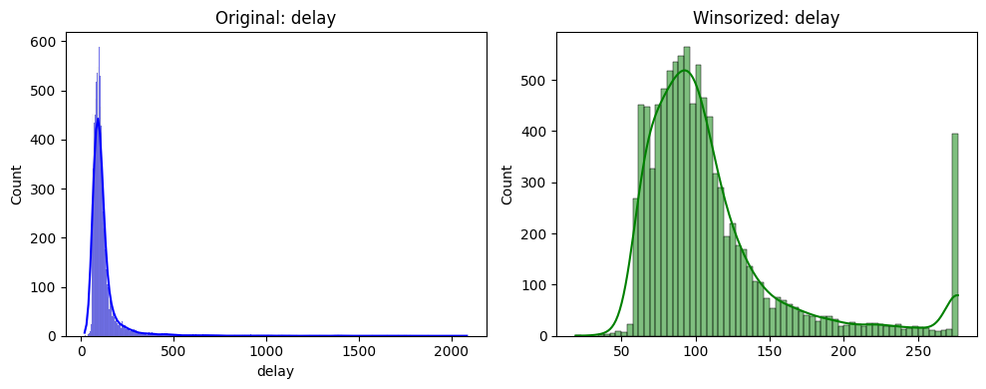
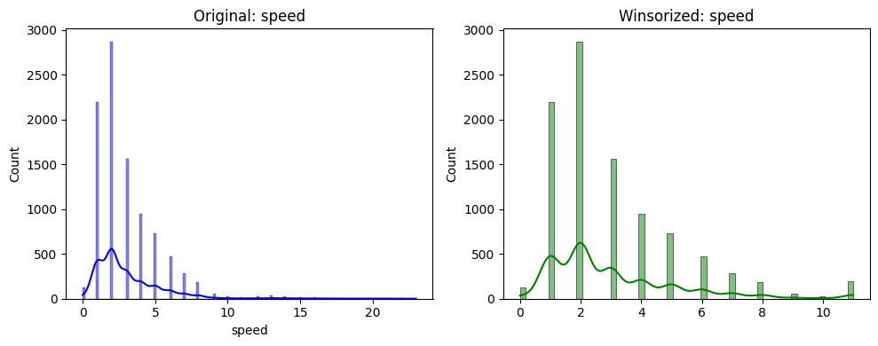
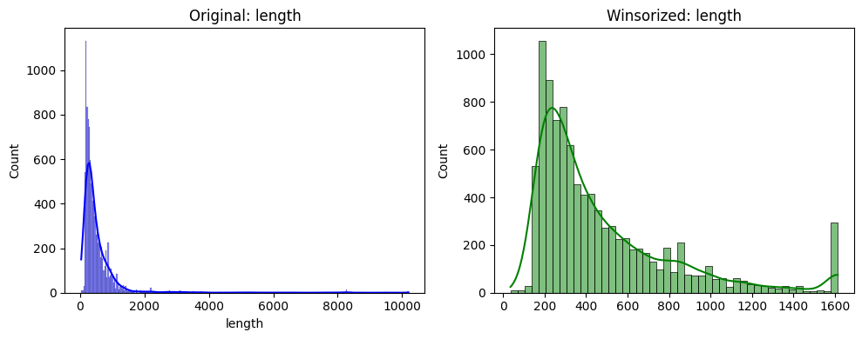
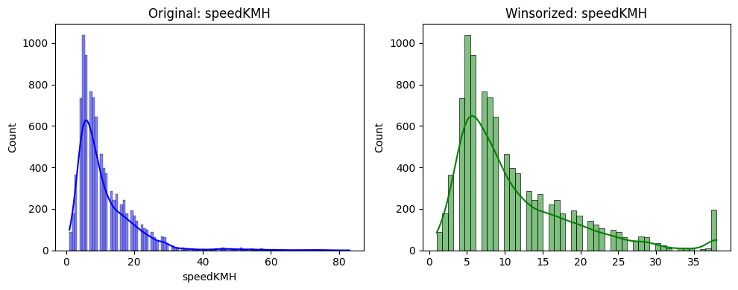
Winsorization
96th Percentile
Skewness: 7.92 to 1.92
98th Percentile
Skewness: 2.70 to 1.53
97th Percentile
Skewness: 7.19 to 1.67
98th Percentile
Skewness: 2.78 to 1.51

Slide 22
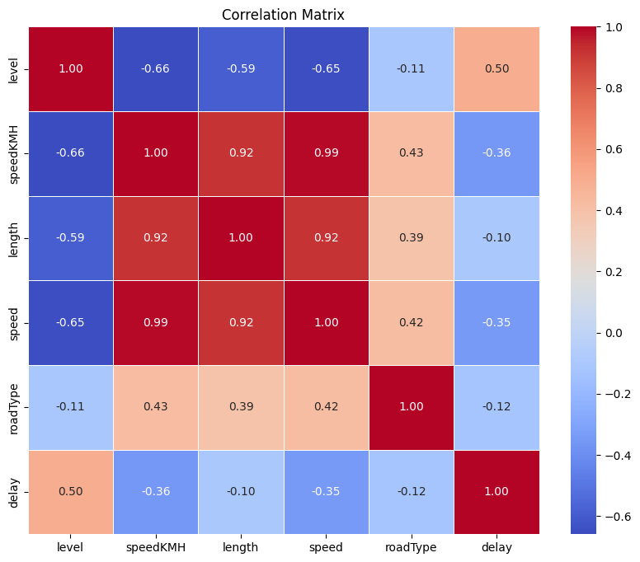
Statistical Testing
Feature | Test Used | Statistic (t/F/ρ/r) | p-value
speedKMH | Pearson Correlation | r = -0.360 | <0.001
length | Pearson Correlation | r = -0.098 | <0.001
speed | Pearson Correlation | r = -0.346 | <0.001
street_freq | Pearson Correlation | r = 0.037 | <0.001
hour | Pearson Correlation | r = 0.022 | <0.05
weekday | Pearson Correlation | r = 0.059 | <0.001
is_weekend | T-test | t = 5.421 | <0.001
roadType | ANOVA | F = 91.981 | <0.001
level | Spearman Correlation | ρ = 0.626 | <0.001

Slide 23
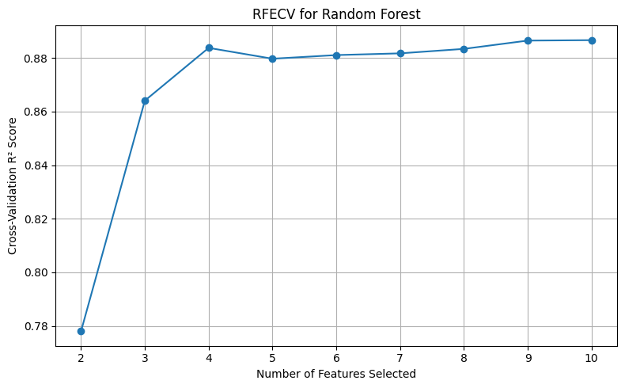
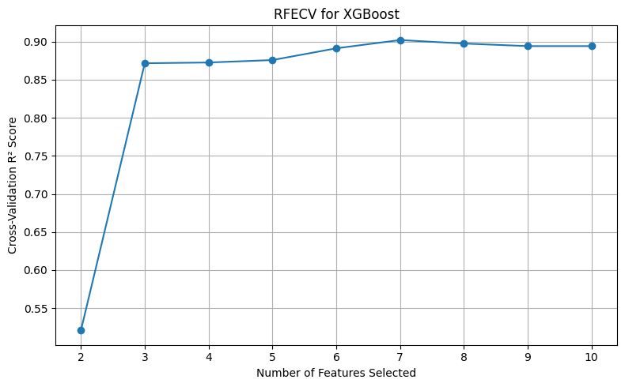
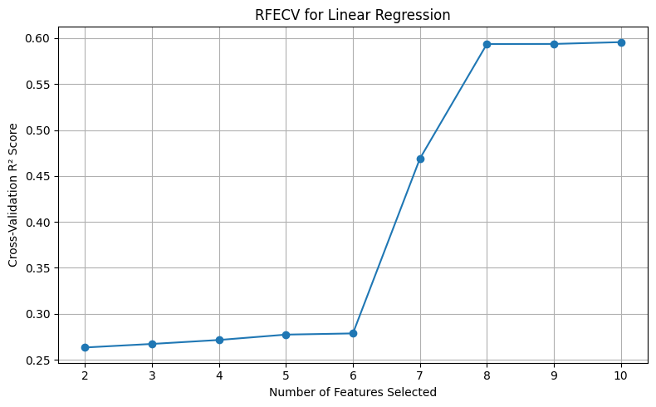
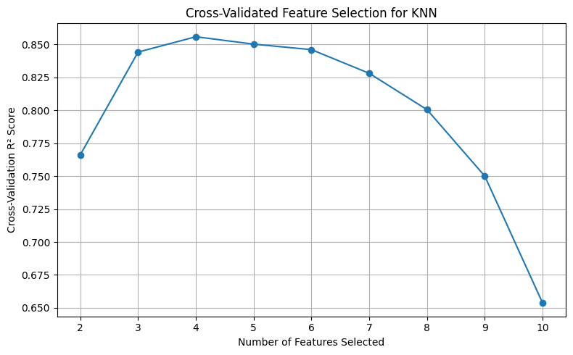
RFECV
RF (10 features)
level
roadType
speedKMH
length
speed
is_Brno
street_freq
hour
weekday
Is_weekend
XGB (7 features)
level
speedKMH
length
speed
roadType
is_Brno
street_freq
LR (10 features)
level
roadType
weekday
speedKMH
length
speed
is_Brno
hour
is_weekend
KNN (4 features)
level
speedKMH
length
Is_Brno

Slide 24
Hyperparameter Tuning
Used GridSearchCV with 5-fold cross-validation to search predefined parameter grids for each model.
Evaluation metric: R² score (selected for regression performance).
Model | R² Before Tuning | R² After Tuning | Best Parameters
Random Forest | 0.8645 | 0.8755 | n_estimators=300, max_depth=None, max_features=‘None', min_samples_split=2, min_samples_leaf=2
XGBoost | 0.8833 | 0.8933 | n_estimators=600, learning_rate=0.1, max_depth=5, colsample_bytree=0.8, subsample=1.0, min_child_weight=3
Linear Regression | 0.6093 | 0.6093 | fit_intercept=True, positive=False, copy_X=True, n_jobs=None
KNN | 0.8243 | 0.8270 | n_neighbors=13, weights=‘distance', p=1 (Manhattan), leaf_size=30, knn__algorithm=ball_tree

Slide 25
Result Analysis
Model Types | Model | Features | Best R² (Train CV) | R² (Test) | MAE | RMSE | MAPE
Tree-Based Model | XGBoost | 7 | 0.902 | 0.893 | 9.20 | 15.69 | 8.56%
 | Random Forest | 10 | 0.888 | 0.876 | 9.97 | 16.95 | 9.21%
Instance-Based Model | KNN | 4 | 0.860 | 0.827 | 11.56 | 19.98 | 10.83%
Linear Model | Linear Regression | 10 | 0.596 | 0.609 | 20.87 | 30.02 | 19.79%
Notes:
Tree-Based Models performed best overall.
XGBoost achieved the highest R² (Test) = 0.892, with MAE = 14.66 and RMSE = 34.97.
Random Forest also had strong performance (R² = 0.86), but slightly worse generalization compared to XGBoost.
Instance-Based Model (KNN) performed competitively (R² = 0.874) despite using only 4 features.
Linear Regression showed significantly lower predictive accuracy (R² = 0.26), indicating the relationship between predictors and the target is non-linear.

Slide 26
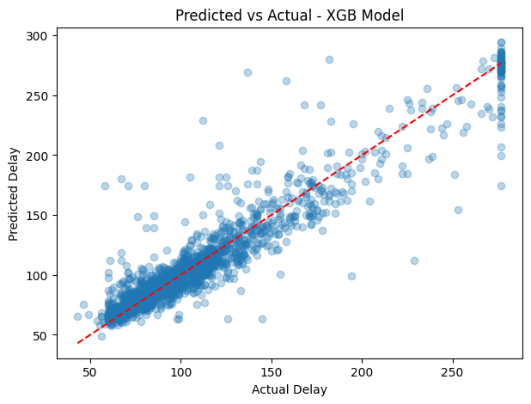
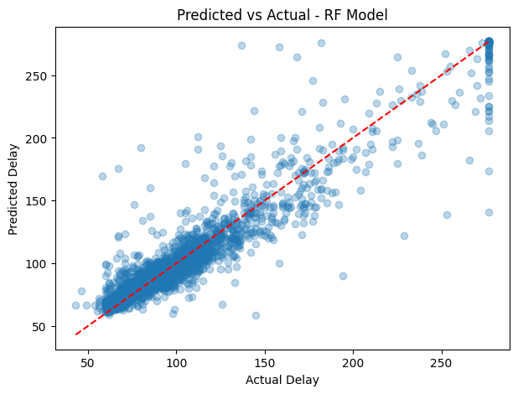
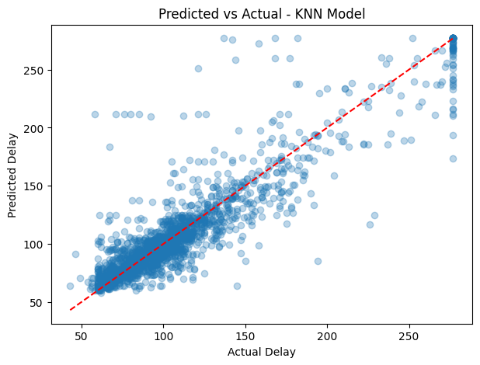
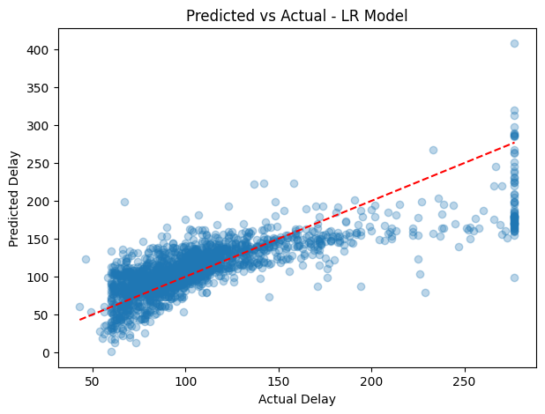
Predicted vs Actual Analysis
XGBoost and Random Forest, predictions aligned closely with actual delays
KNN predictions showed moderate alignment but tended to diverge at higher delay values
Linear Regression predictions were widely scattered

Slide 27
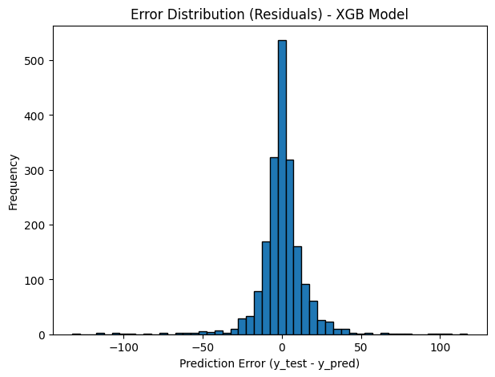
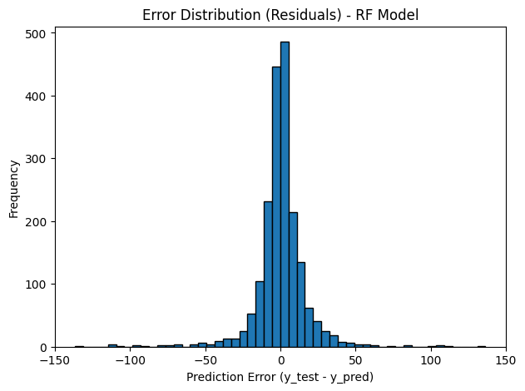
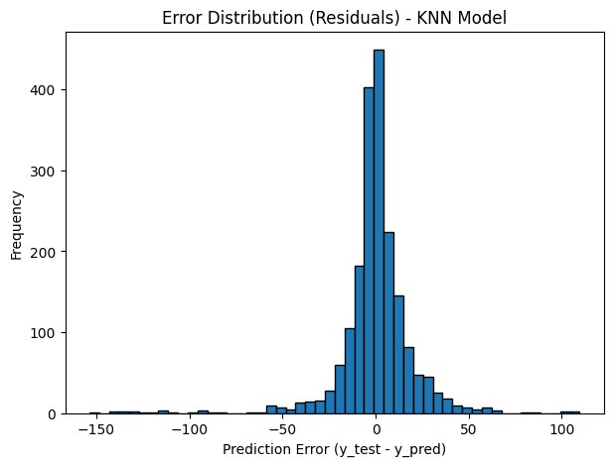
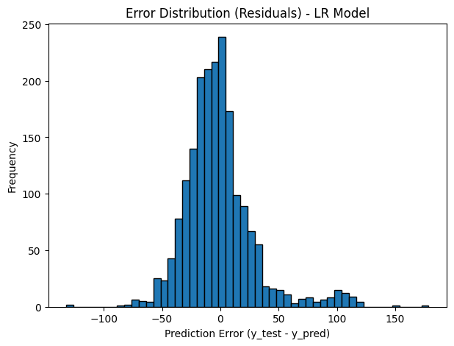
Error Distribution
XGBoost exhibited the narrowest residual spread
Random Forest residuals were also centered near zero but with slightly wider dispersion
Linear Regression produced the widest and most skewed residuals
KNN showed heavier tails and wider spread

Slide 28
Predicted vs Actual Analysis - XGB
Errors centered around 0 → no major bias
Most errors within ±25 seconds
Few outliers → extreme cases harder to predict
Strong alignment with 45° line → high accuracy
Accurate for normal delays (50–150 seconds)
Slight underprediction for extreme delays (>250 seconds)

Slide 29
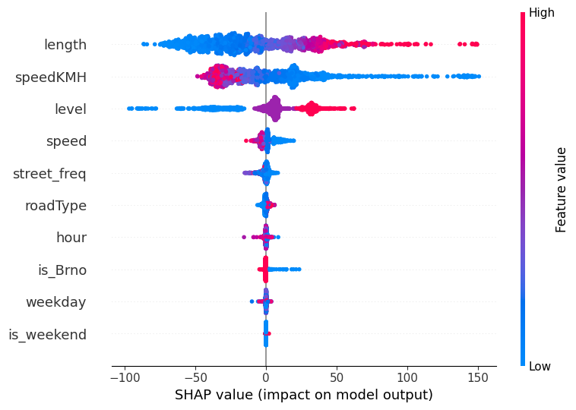
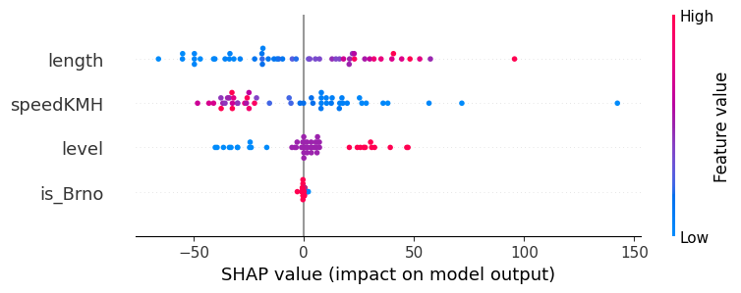
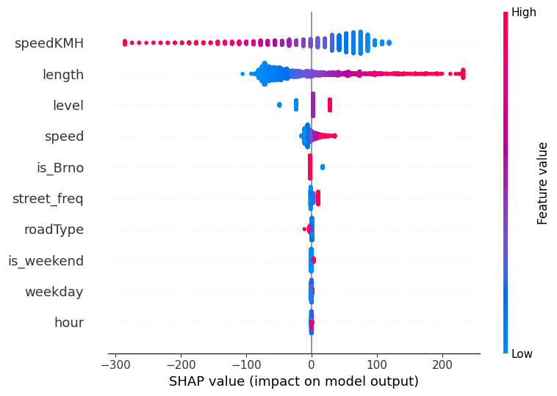
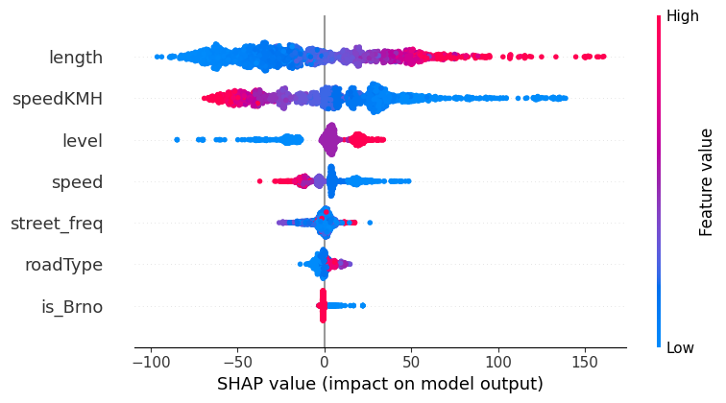
SHAP Analysis
RF
KNN
LR
XGB

Slide 30
SHAP Analysis - XGB
Length and speedKMH have the strongest impact (both positive and negative).
XGBoost emphasizes contextual factors (congestion, road type, city, street)
Captures broader real-world influences on delays.

Slide 31
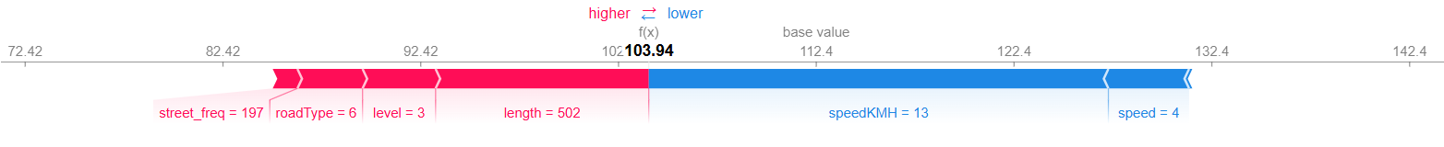
SHAP Analysis
The base value is 112.4, and the final prediction for this case is 103.94.
Red features increase the prediction, while blue features decrease it.
The main increasing factors are street_freq = 197, roadType = 6, level = 3 and length = 502.
The main decreasing factors are speedKMH = 13 and speed = 4 leading to an overall reduction.

Slide 32
Discussion (Model Comparison)
Tree-based models outperformed both linear and instance-based models in all metrics.
Traffic delay is a non-linear problem and influenced by complex interactions between factors.
XGBoost’s boosting approach sequentially learns from previous errors, enabling it to capture subtle patterns that Random Forest’s bagging-based method may miss.
XGBoost is selected as the finalmodel as it achieved highest R² (0.893) and lowest MAE (9.20), RMSE (15.69) and MAPE (8.56%).
XGBoost is selected as the final model for deployment.

Slide 33
Discussion (Feature Insights)
Trip length and speedKMH consistently dominate across models.
Congestion level also strongly impacted delays.
Tree-based models (RF, XGB) leverage temporal/contextual features.
KNN relies on fewer dominant features.
Linear Regression overemphasizes linear effects, especially speedKMH.

Slide 34
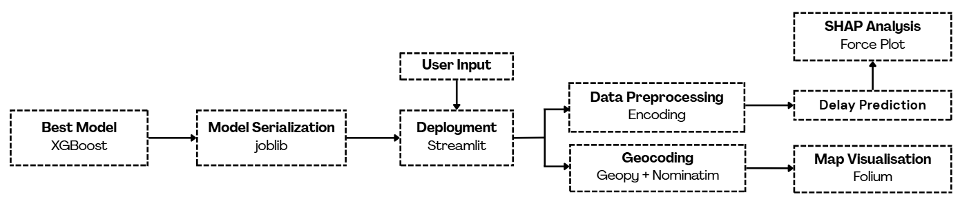
Deployment - Architecture

Slide 35
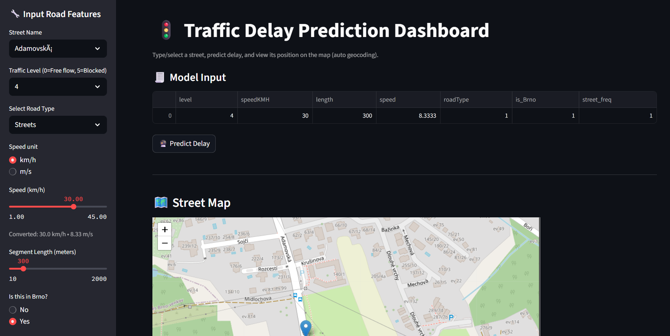
Deployment
Interactive dashboard for predicting traffic delay based on road and traffic conditions.
Allows users to input road parameters and instantly get predictions.

Slide 36
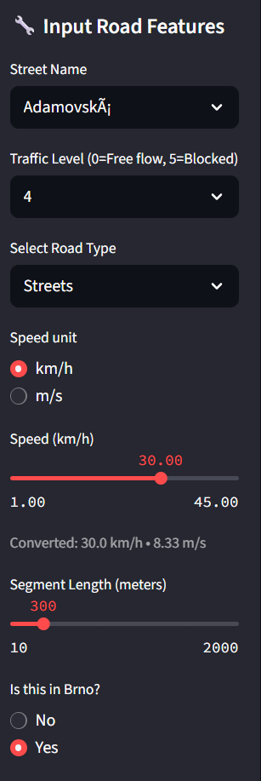
Deployment
User selects street name and road types.
Other inputs include traffic level, speed, segment length, location (Brno/Not Brno)
Model input preprocessing (conversion, street frequency lookup).

Slide 37
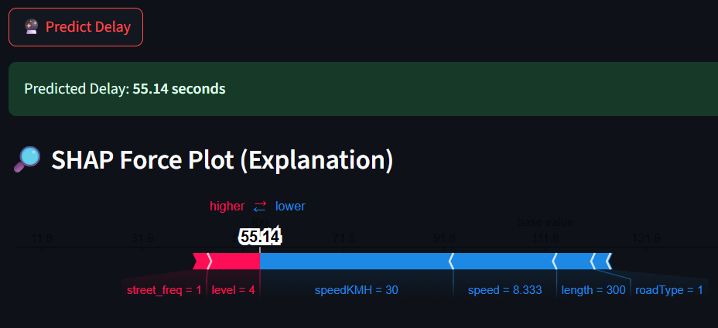
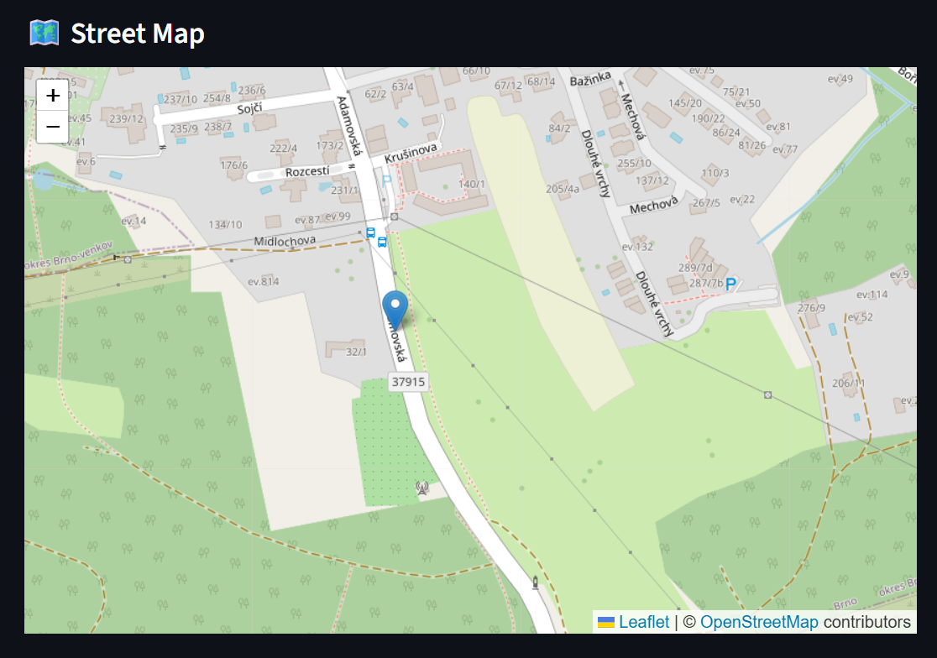
Deployment
Displays prediction in seconds.
Shap force plots for each feature contributions
Shows street location on an interactive map with marker and popup info.

Slide 38
Conclusion
A traffic delay prediction system using machine learning was developed, with XGBoost as the best-performing model.
Reduces dependence on traditional traffic monitoring infrastructure.
Demonstrates a cost-effective and scalable solution using crowdsourced and existing traffic data.
Deployed as an interactive Streamlit dashboard for real-time prediction and map visualisation, suitable for areas with limited infrastructure.

Slide 39
Conclusion
Objectives | Result
To explore the crowdsourced data integration methods with traffic prediction system. | Successfully integrated Waze crowdsourced traffic data into the prediction system. Preprocessed data with data cleaning and encoding for model compatibility. Engineered time-based features (hour, weekend indicator) to improve prediction accuracy
To predict traffic congestion based on data from crowdsourced platforms using machine learning models. | Built a prediction system using multiple ML models (Random Forest, XGBoost, KNN, Linear Regression) trained on Waze data Performed feature selection and hyperparameter tuning to retain the most predictive variables
To evaluate the performance of various models in terms of MAE, RMSE, R² and MAPE. | Assessed all models using these metrics and compared results XGBoost achieved the highest accuracy and lowest error values across evaluation metrics

Slide 40
Limitations & Future Works
Limitation | Future Works
Waze data may be incomplete in less-populated areas. | Integrate additional data sources to improve coverage in underrepresented regions.
The study used historical data; real-time prediction may face latency issues. | Develop a streaming architecture for live traffic prediction and rapid updates.
Only Waze-derived features were used, missing external influencing factors. | Include additional contextual variables like weather, road conditions, and road events.
Difficulty in acquiring comprehensive and high-quality local traffic data due to privacy restrictions and data-sharing limitations. | Establish partnerships with local authorities and agencies to access richer datasets while ensuring compliance with privacy regulations.

Slide 41
References
Aljuaydi, F., Wiwatanapataphee, B., & Wu, Y. H. (2023). Multivariate machine learning-based prediction models of freeway traffic flow under non-recurrent events. Alexandria engineering journal, 65, 151-162.
Bai, M., Lin, Y., Ma, M., Wang, P., & Duan, L. (2021). PrePCT: Traffic congestion prediction in smart cities with relative position congestion tensor. Neurocomputing, 444, 147-157.
Bilotta, S., Collini, E., Nesi, P., & Pantaleo, G. (2022). Short-term prediction of city traffic flow via convolutional deep learning. IEEE Access, 10, 113086-113099.
Duan, J. H., Li, W., Zhang, X., & Lu, S. (2022). Forecasting fine-grained city-scale cellular traffic with sparse crowdsourced measurements. Computer Networks, 214, 109156.
Huang, Z., & Loo, B. P. (2023). Urban traffic congestion in twelve large metropolitan cities: A thematic analysis of local news contents, 2009–2018. International journal of sustainable transportation, 17(6), 592-614.
Niu, H., & Silva, E. A. (2020). Crowdsourced data mining for urban activity: Review of data sources, applications, and methods. Journal of Urban Planning and Development, 146(2), 04020007.

Slide 42
References
Hu, S., Wang, K., Li, L., Zhao, Y., He, Z., & Zhang, Y. (2024). Multi-crowdsourced data fusion for modeling link-level traffic resilience to adverse weather events. International Journal of Disaster Risk Reduction, 112, 104754.
Tay, L., Lim, J. M. Y., Liang, S. N., Keong, C. K., & Tay, Y. H. (2023). Urban traffic volume estimation using intelligent transportation system crowdsourced data. Engineering Applications of Artificial Intelligence, 126, 107064.
Osei, K. K., Adams, C. A., Sivanandan, R., & Ackaah, W. (2022). Modelling of segment level travel time on urban roadway arterials using floating vehicle and GPS probe data. Scientific African, 15, e01105.
Qaddoura, R., Younes, M. B., & Boukerche, A. (2024). Towards optimal tuned machine learning techniques based vehicular traffic prediction for real roads scenarios. Ad Hoc Networks, 161, 103508.
NazirkarReshma, R., & Rajabhushanam, C. (2022). Machine learning algorithms performance evaluation in traffic flow prediction. Mater. Today: Proc., 51(Part 1), 1046-1050.
Yi, Z., Liu, X. C., Markovic, N., & Phillips, J. (2021). Inferencing hourly traffic volume using data-driven machine learning and graph theory. Computers, Environment and Urban Systems, 85, 101548.

Slide 43
Q&A Thank You

